Slide 1

Ensuring Organizational Security Through Intrusion Detection
Jack Noble
Master of Business Analytics (MBAn)

Slide 2

Introduction
The fictitious Northwood Bank (Toledo, OH) seeks to enhance its cybersecurity systems by using predictive analytics to detect and prevent unauthorized access to its systems.
Project Objective:
Identify patterns in historical network traffic data
Build predictive models to classify malicious intrusions
Improve response time and reduce false positives in threat detection
Project Scope:
Internal network traffic reports for training, evaluation, and deployment
Compare and contrast various models based on performance metrics (accuracy, precision, recall, kappa, AUC)
Provide recommendations based on model diagnostics and feature importances

Slide 3

Methodology (EDA)
Exploratory data analysis (EDA) is conducted to reveal historical patterns, anomalies, and relationships in the network data, allowing for informed model selection and preprocessing techniques.
Approach:
Leverage Python libraries (e.g., pandas, NumPy, Matplotlib, seaborn, etc.) to visualize and summarize data
Create graphs (e.g., bar charts, box plots, or histograms) to uncover hidden trends, distributions, outliers and correlations between variables
Use descriptive statistics to uncover data spread and identify potentially skewed features or missing data

Slide 4

Methodology (ML)
Machine learning models are trained on historical network traffic data using supervised learning algorithms to simulate intrusion detection performance under realistic conditions.
Strategy:
Leverage Python libraries (e.g., scikit-learn, and PyDotPlus) to create and visualize predictive models
Preprocess data by encoding categoricals, fixing class imbalances, and selecting feature/target variables
Build and evaluate multiple classification models (Logistic Regression, Multilayer Perceptron, Classification Tree)
Evaluate performance across multiple random weight seeds and partitions
Use metrics such as precision, accuracy, recall, kappa score, and AUC values to compare and validate models
Implementation:
Visualize results with confusion matrices, ROC curves, and feature importance plots
Document findings for technical and executive review
Post-Processing:
Use pandas’ .merge() function to re-merge with original data by the unique “Id” for each row, matching prediction rows (i.e., testing data) to their original counterparts, to rows without any predictions at all - providing one single source of truth for auditability.
Export the rebuilt datasets (original, decoded data with predictions/no predictions) from each model into their own unique .csv files

Slide 5
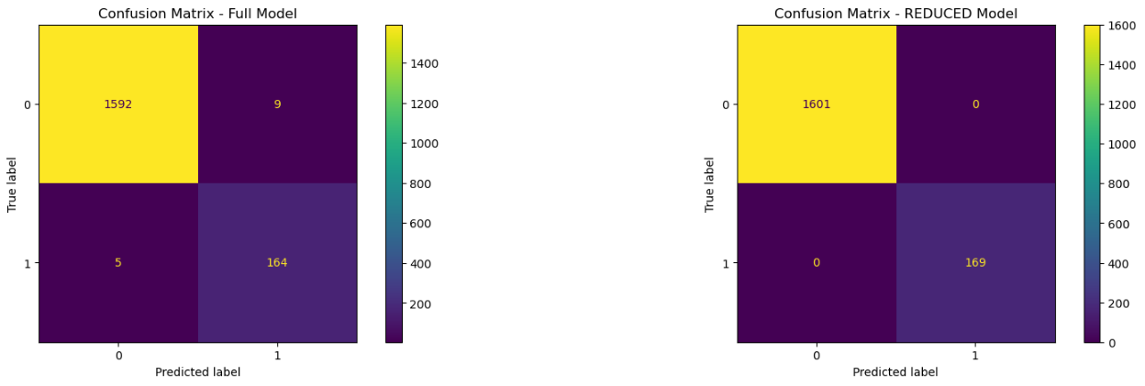
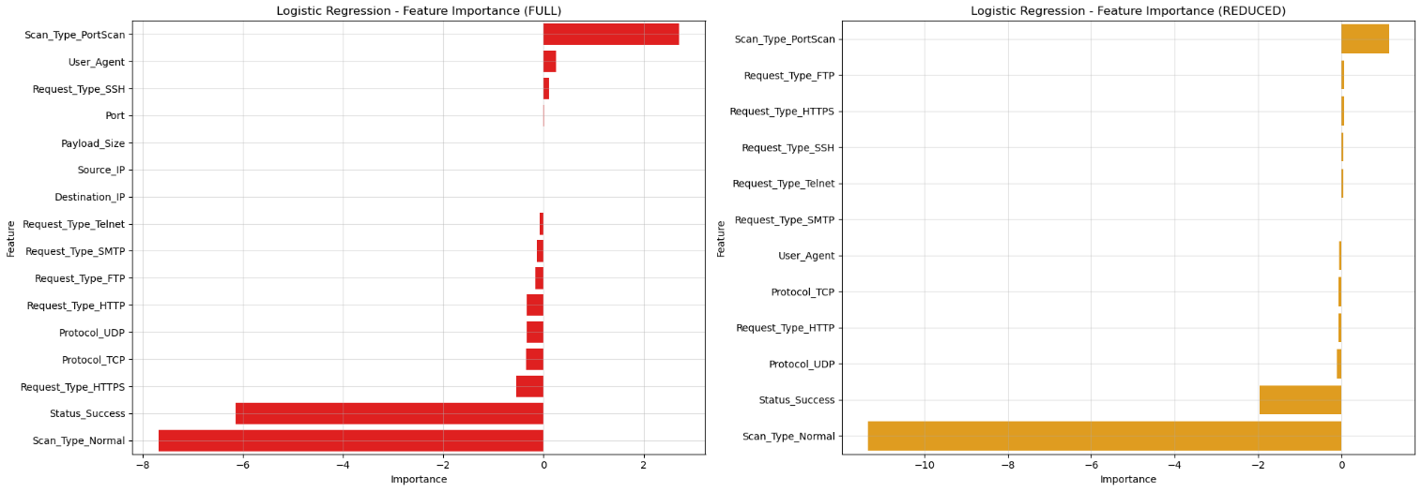
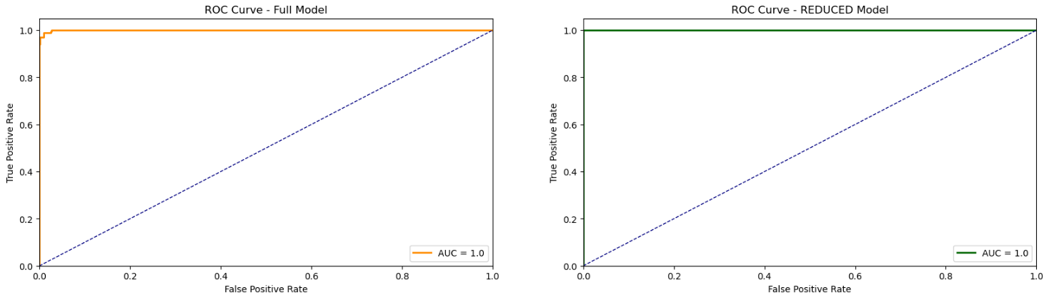
Results (LR)
Two Logistic Regression (LR) models were trained to differentiate between intrusive and benign network traffic behaviors.
Full Model:
Evaluated performance across multiple random partitions (train-test-splits)
Used a broad feature set to establish a baseline performance standard for future modeling efforts
Achieved very high accuracy (99.21%) and recall (99.71%) i.e., minimal false negatives – few intrusions were missed
Kappa score of 0.955 indicates almost no randomness
An AUC of 0.9995 nearly flawless class separability
Reduced Model:
Evaluated performance across multiple random partitions (train-test-splits)
Simpler architecture (removed “Port”, “Payload_Size”, “Source_IP” and “Destination_IP” variables) for better performance
Achieved perfect accuracy (100%) and recall (100%) i.e., no intrusions were missed; all network activity was correctly classified
Kappa score of 1.0 indicates no predictive randomness
An AUC score of 1.0 shows flawless class separability

Slide 6
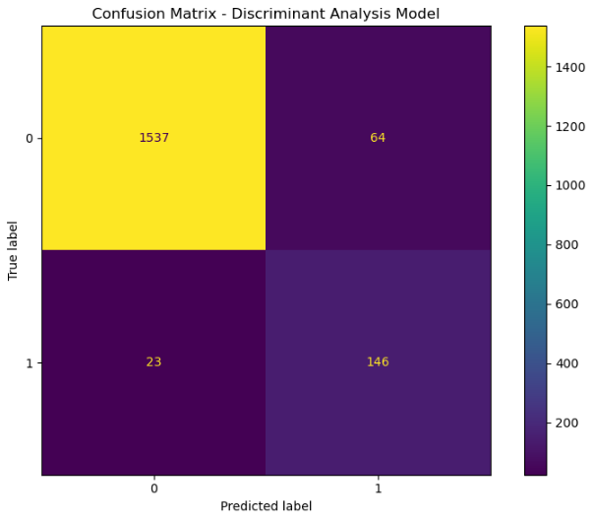

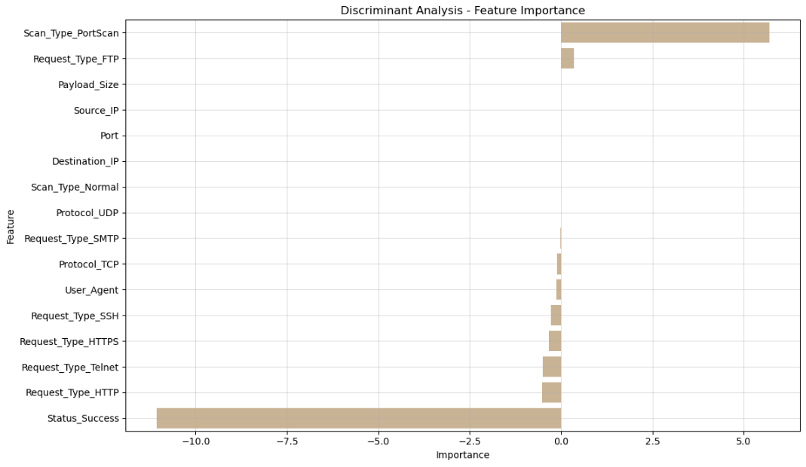
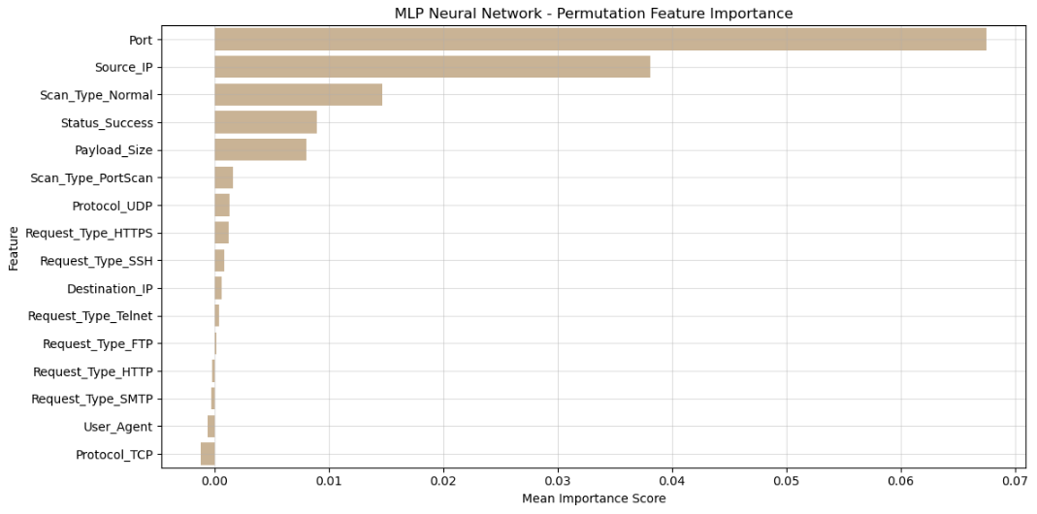
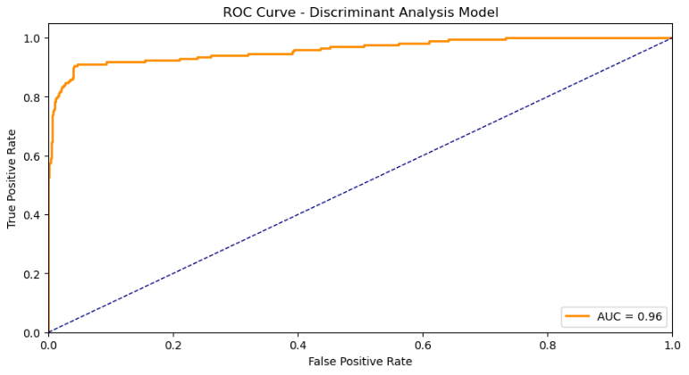
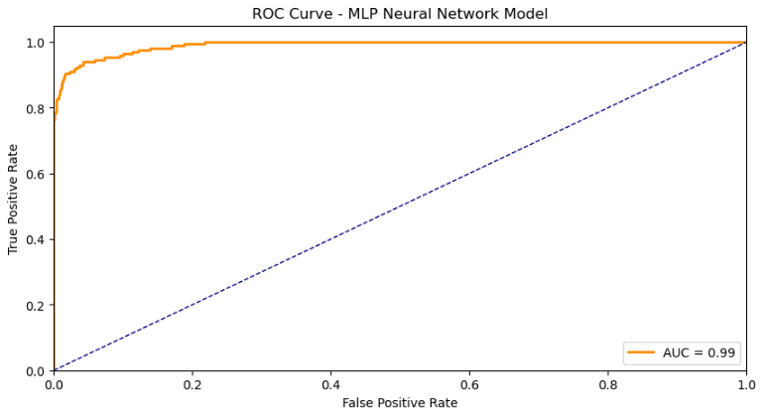
Results (DA & MLP)
Two additional models, Discriminant Analysis (DA) and a Multilayer Perceptron (MLP) Neural Network were trained to identify network behavior types and compared against the benchmark (LR) models.
Discriminant Analysis:
Evaluated using multiple random train-test-splits
Achieved accuracy of (96.5%) and recall (86.4%) i.e., higher false positives and more intrusions were missed than the Logistic Regression models
Top features for predicting intrusions included “PortScan”, “Status_Success”, and “Request_Type_FTP”
Kappa score of 0.743 indicates little randomness in predictions, suggesting a higher rate of misclassification
AUC score of 0.96 shows very strong class separation
MLP Neural Network:
Trained with shallow architecture (1 hidden layer, 100 neurons) and weight updates via backpropagation
Reached accuracy (98.5%) and recall (91.7%) i.e., it was better at recognizing all classes, including intrusions than the DA model - but not the LR models.
“Port”, “Source_IP”, and “Scan_Type_Normal” were the model’s top predictors
Kappa score of 0.806 shows less randomness in predictions than DA, but still not as high as LR models
AUC score of 0.99 shows near-perfect class separability

Slide 7
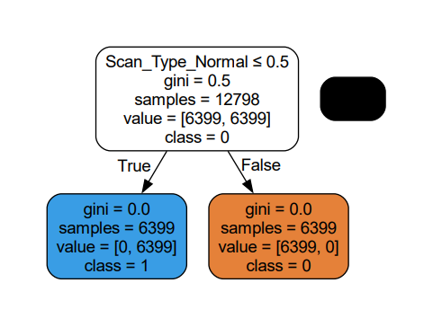
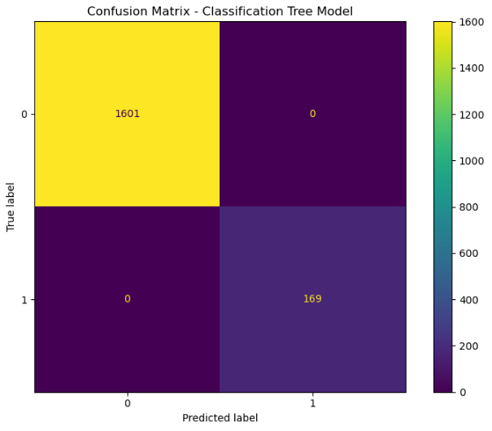
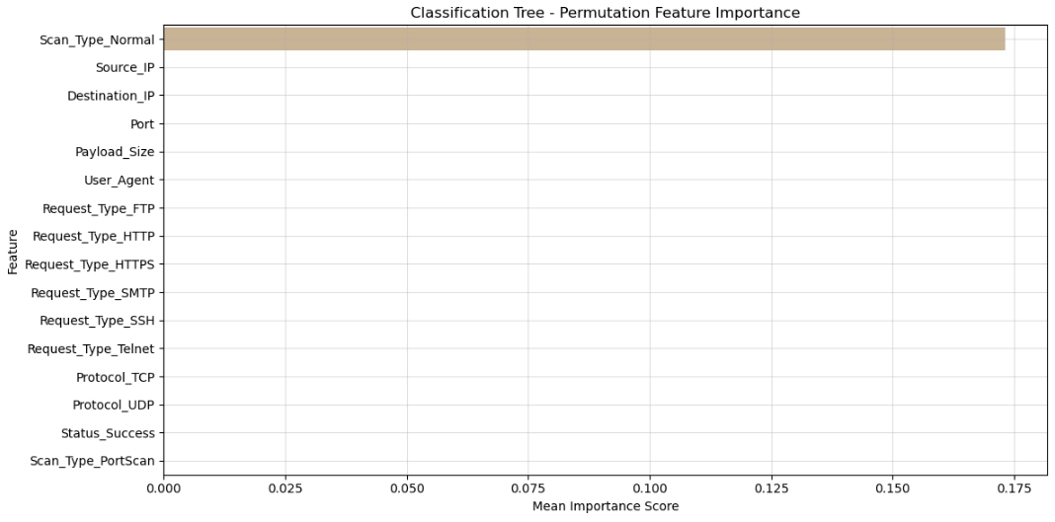
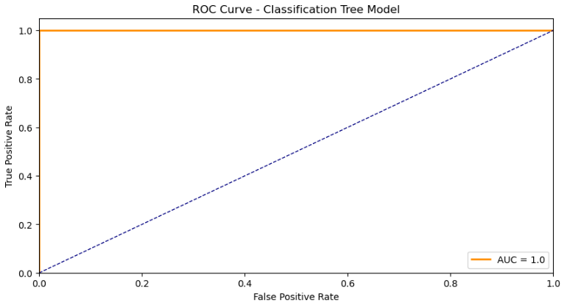
Results (CT)
The final (generally) highly-interpretable model, a Classification Tree (CT) was trained on the same dataset and then measured against the same benchmark (LR) and other models (MLP and DA).
Classification Tree:
Evaluated performance across multiple random partitions (train-test-splits)
Achieved perfect accuracy (100%) and recall (100%) i.e., no intrusions were missed, all activity was correctly classified
A Kappa score of 1.0 confirms zero randomness in classifications
An AUC of 1.0 confirms flawless class separability
SMOTE oversampling (used to fix the class imbalance in the “Intrusion” target variable) seems to have over-replicated patterns tied to “Scan_Type_Normal”, causing the tree to split entirely on this feature alone
Alarmingly, perfect scoring and reliance on a single variable (“Scan_Type_Normal”) strongly suggests the Classification Tree model is overfitting (likely due to SMOTE oversampling) – severely limiting its generalizability on future real-world data.

Slide 8

Conclusion
Predictive analytics can significantly enhance network security, but model selection and data preprocessing techniques are critical for trustworthy performance.
Key Takeaways:
Logistic Regression models outperformed all others, leveraging dominant categorical features via effective preprocessing to achieve near-perfect accuracy, recall, and class separation
The Multilayer Perceptron achieved strong results, confirming viability of shallow neural networks for this task
Discriminant Analysis demonstrated reduced effectiveness, with lower accuracy and recall leading to several missed intrusions
While highly-interpretable, the Classification Tree unfortunately showed signs of severe overfitting due to SMOTE-induced bias in a single feature (“Scan_Type_Normal”)
Final Verdict:
Predictive models can be successful in identifying intrusions with high reliability by using classification models
Logistic Regression is a powerful baseline for intrusion detection and should not always be overlooked in favor of more complex models, like MLPs
Future real-time applications should prioritize interpretability, speed, and robustness against performance-drift

Slide 9

Literature Review
Our results reflect key findings in current literature on machine learning, synthetic data generation, and cybersecurity, thus validating our model selection, interpretation strategies, and conclusions.
Supporting Evidence:
“Using SMOTE helps to better predict computational processes especially in intrusion detection systems, improving both accuracy and F1 scores across tree-based models” (Nugroho et al., 2023). Despite our revealing limitations in some models, when applied properly SMOTE can improve classification in intrusion detection systems.
SMOTE has been shown to significantly improve intrusion detection accuracy by correcting class imbalances, particularly in cybersecurity datasets (Ahmed et al., 2022).
“SMOTE patterns are not genuine as they are not generated from the original minority class distribution” (Elreedy, et al., 2023). This can mislead overly flexible models, such as tree-based models which are prone to overfitting based on synthetic, exacerbated signals. This is exactly what we observed with our classification trees over-reliance on the “Scan_Type_Normal” feature.
Our multilayer perceptron model failed to outperform logistic regression, likely due to the dataset being more tabular and lacking the complex feature structure that neural networks are designed for. “For structured data tasks, simpler models like logistic regression often outperform deep learning due to lack of hierarchical patterns” (Shwartz-Ziv & Armon, 2022).
Model interpretability is imperative in cybersecurity. “IDSs designed using Deep Learning (DL) techniques are often treated as black box models and do not provide a justification for their predictions.” – “One solution to this problem is to design explainable IDS (X-IDS)” (Neupane et al., 2022).

Slide 10

Lessons Learned
The careful consideration of modeling techniques including preprocessing, architecture, evaluation, and model transparency are essential in security-based classification tasks.
Modeling Observations:
SMOTE can enhance performance but its synthetic data generation patterns risk overfitting, especially in models like classification that are sensitive to exaggerated feature importance
Neural networks, while capable, did not outperform simpler models due to the tabular structure and lack of complex features in the dataset
Future Enhancements:
Prioritize interpretability when model transparency is essential such as in cybersecurity. When explainability drives stakeholder trust and engagement, simpler models (such as Logistic Regression) are usually preferred even with a small performance cost
Consider looping structures to dynamically tune hyperparameters, reducing overfitting and increasing model performance

Slide 11

Recommendations
Predictive analytics can help Northwood Bank safeguard against unauthorized access to their critical systems. By leveraging machine learning algorithms like logistic regression, threats can be proactively identified and mitigated through targeted policy recommendations and technical enhancements.
Operational Recommendations:
Actively monitor and explore rate-limiting behaviors for port scanning. It is often the first step of a cyberattack, allowing malicious actors to identify potential entry points. The “Scan_Type_PortScan” feature was the strongest indicator of an attack
Block or restrict FTP protocol usage on the network unless absolutely needed. The “Request_Type_FTP” appeared as the second most powerful predictor of intrusive activity in the reduced (and most accurate) Logistic Regression model and is rarely used in modern networking environments (it is unencrypted)
Model Maintenance Recommendations:
Integrate automated hyperparameter tuning to avoid manual trial-and-error time sinks (e.g., GridSearchCV, exhaustive search of all parameter values or RandomizedSearchCV – more efficient but doesn’t search all combinations)
Incorporate cross-validation (Kfold and cross_val_score) to validate model stability across different data splits to prevent overfitting
These insights provide a foundation for scalable, and secure ML deployment in real-world cybersecurity contexts.

Slide 12
Thank you!

Slide 13
References
Original Kaggle Dataset: https://www.kaggle.com/datasets/developerghost/intrusion-detection-logs-normal-bot-scan
Li, L.-H., Ahmad, R., Tanone, R., & Sharma, A. K. (2023). STB: Synthetic Minority Oversampling Technique for tree‑boosting models for imbalanced datasets of intrusion detection systems. PeerJ Computer Science, 9, e1580. https://doi.org/10.7717/peerj-cs.1580
Ahmed, H. A., Hameed, A., & Bawany, N. Z. (2022). Network intrusion detection using oversampling technique and machine learning algorithms. PeerJ Computer Science, 8, e820. https://doi.org/10.7717/peerj-cs.820
Elreedy, D., Atiya, A. F., & Kamalov, F. (2023). A theoretical distribution analysis of synthetic minority oversampling technique (SMOTE) for imbalanced learning. Machine Learning, 113(7), 4903–4923. https://doi.org/10.1007/s10994-022-06296-4
Shwartz-Ziv, R., & Armon, A. (2022). Tabular data: Deep learning is not all you need. Information Fusion, 81, 84–90. https://doi.org/10.1016/j.inffus.2021.11.011
Neupane, S., Ables, J., Anderson, W., Mittal, S., Rahimi, S., Banicescu, I., & Seale, M. (2022). Explainable Intrusion Detection Systems (X‑IDS): A survey of current methods, challenges, and opportunities [Preprint]. arXiv. https://arxiv.org/abs/2207.06236

